Slide 1
SOC 120
Education and Inequality

Slide 2
The Educational System
A poor quality education locks children into a low position on the social hierarchy. As Kozol states:
“We are children only once; and after those few years are gone, there is no second chance to make amends. In this respect, the consequences of unequal education have a terrible finality. Those who are denied cannot be “made whole” by a later act of government. Those who get the unfair edge cannot be later stripped of what they’ve won (1981, p. 180).

Slide 3
The Educational System
High School Drop-outs:
Uncaring teachers
Inadequate access to counseling
Irresponsible administrators
A high teacher to student ratio
Outdated curricula
Deteriorating school facilities

Slide 4
Latinos
Blacks
Whites
© 2010 The McGraw-Hill Companies, Inc. All Rights Reserved.
Notes:
Derived from Racial Domination, Racial Progress, p. 318

Slide 5
© 2010 The McGraw-Hill Companies, Inc. All Rights Reserved.
Notes:
Derived from Racial Domination, Racial Progress, p. 317

Slide 6
“Positive” Stereotype?
Slide 34
Every “positive” stereotypical statement invokes its antipode
“To be intelligent
is to be calculating and too clever;
to be gifted in math and science
is to be mechanical and not creative;
to be polite
is to be inscrutable and submissive;
to be hard working
is to be an unfair competitor for regular human beings.”
~Frank Wu
© 2010 The McGraw-Hill Companies, Inc. All Rights Reserved.
Notes:
Frank Wu, Yellow (New York: Basic Books, 2002), p. 68.

Slide 7
Oppositional Culture
Slide 35
A collection of linguistic, behavioral, aesthetic, and spiritual attitudes and practices formed in direct opposition of mainstream white culture
“Selling out”
“Acting white”
Molded by structural and historical forces; rooted in slave times and conditioned by economic inequality
Many scholars have been critical of the way this concept has been used
© 2010 The McGraw-Hill Companies, Inc. All Rights Reserved.

Slide 8
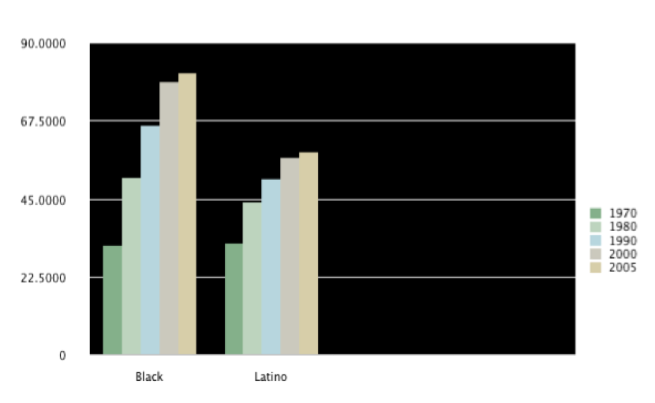
The Educational System
The following chart shows the increase in the high school educational attainment of Blacks and Latinos from 1970 – 2005 (U.S. Census, 2007).

Slide 9
The Educational System
Does tracking contribute to the educational gap? In many schools tracking, which is assigning students to a specific curriculum based on their test scores and other criteria is common practice.
Researchers argue that while African American students are commonly placed in general classes, White students are commonly placed in college preparatory courses.
Researchers also argue that African American students are more likely than White students to be classified as learning disabled or emotionally disturbed.
These common practices represent ways in which we infuse our educational system with segregation.

Slide 10
The Educational System
Obstacles to graduation:
Reduced financial aid
Disparity between education and viable job opportunities
Incidences of race-based hate crimes on college campuses.

